Slide 1


Project Title -Seasonal Agriculture Performance Analysis
Student Name – Goutam Patil ,
College Name- Bansal Institute of Research Science and Technology
AICTE STU ID : STU677e2b15c05e41736321813
9/3/2026
Annual Review
‹#›

Slide 2

PROBLEM STATEMENT
  Agricultural activities are influenced by seasonal variations in environmental conditions, farming practices, resource availability and market conditions. As a result, agricultural performance may differ from one season to another. However, raw agricultural data does not clearly explain how agricultural performance changes across seasons or what patterns can be observed in different seasonal conditions. The problem is to analyse the given agricultural dataset and investigate seasonal differences in agricultural performance by identifying meaningful patterns, trends, relationships and variations within the available data.
9/3/2026
Annual Review
‹#›

Slide 3

Project Description
My project is Seasonal Agriculture Performance Analysis. The main purpose of this project is to analyze agricultural data collected under different seasons, geographical areas, and farming conditions. We clean and prepare the dataset, perform exploratory data analysis, compare agricultural performance across seasons, and identify patterns, trends, relationships, and variations. We also analyse resource usage, environmental conditions, and economic outcomes. Finally, we visualize the findings and provide data-driven conclusions and recommendations that can support better seasonal agricultural planning.
9/3/2026
Annual Review
‹#›

Slide 4
WHO ARE THE END USERS?
Seasonal Agriculture Performance Analysis project, the main end users can be:
Farmers – To understand seasonal patterns and make better farming decisions.
Agricultural planners – To use seasonal performance data for agricultural planning.
Agricultural organizations/departments – To study regional and seasonal agricultural trends.
Researchers and data analysts – To analyze relationships between environmental conditions, resources, and agricultural outcomes.
Policy makers – To use data-driven insights for agricultural policies and planning.
Agribusinesses – To understand seasonal production and economic patterns.
9/3/2026
Annual Review
‹#›

Slide 5

Technology Used
Python
Pandas
NumPy
Matplotlib
Seaborn
SciPy
Statsmodels
Google Collab
9/3/2026
Annual Review
‹#›
Notes:
5

Slide 6
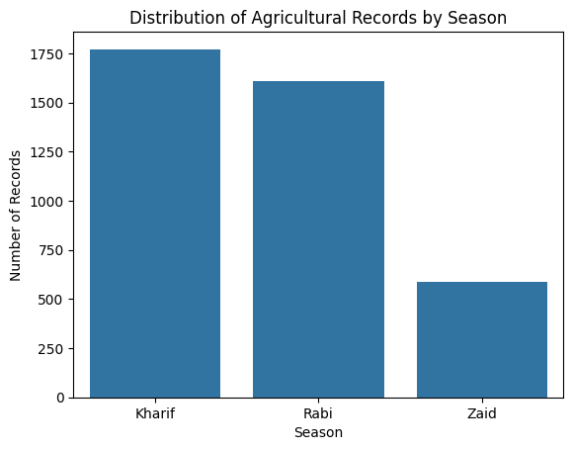
RESULTS
We can see in this Bar chart , The Distribution of Agriculture records by Season clearly.
9/3/2026
Annual Review
‹#›

Slide 7
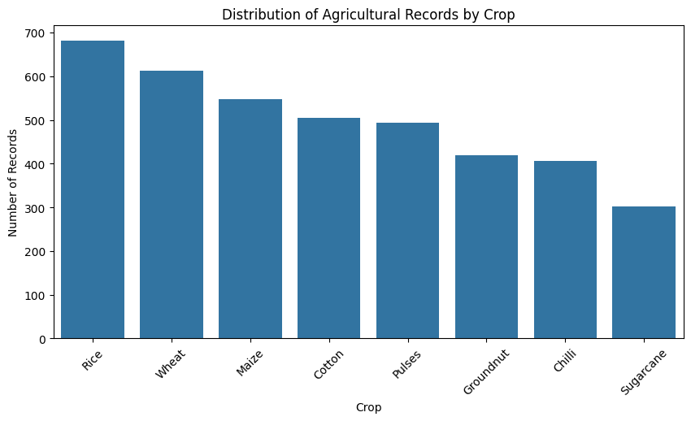
RESULTS
9/3/2026
Annual Review
‹#›

Slide 8
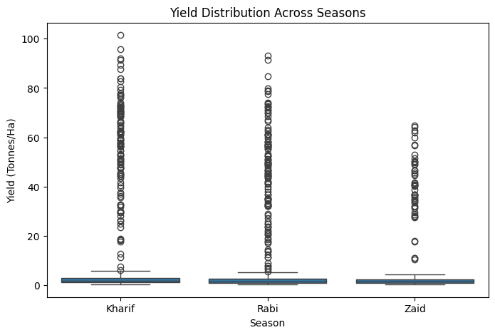
RESULTS
9/3/2026
Annual Review
‹#›

Slide 9
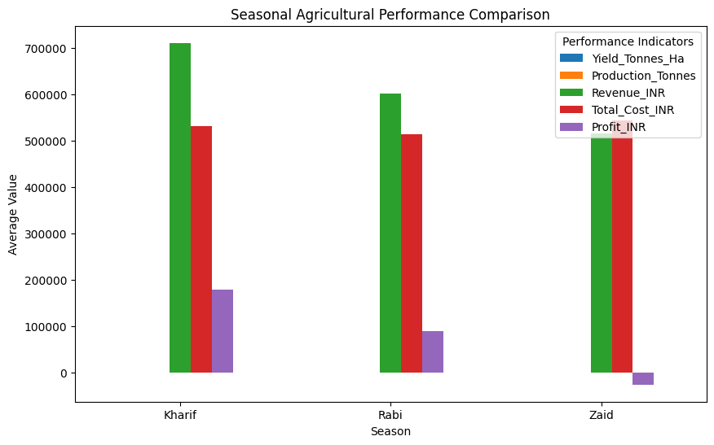
RESULTS
9/3/2026
Annual Review
‹#›

Slide 10
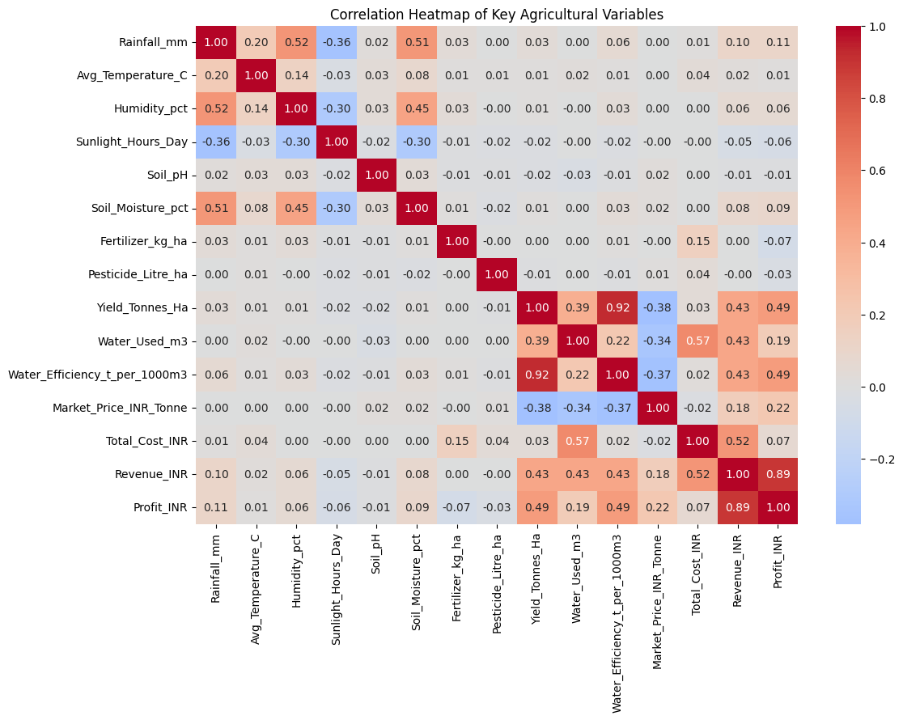
RESULTS
9/3/2026
Annual Review
‹#›

Slide 11
Future scope
Predict future results – We can predict crop performance in the next season using old data.
Add weather data – We can include rainfall, temperature, and humidity data.
Compare different areas – We can compare agriculture in different regions.
Use real-time data – The system can use current farming and weather information.
Use Machine Learning – Machine Learning can help predict agricultural performance.
Create a dashboard – We can make an easy dashboard to show results using charts and graphs.
Better farming decisions – The results can help farmers and agricultural organizations plan better for each season.
9/3/2026
Annual Review
‹#›

Slide 12
GitHub Link
https://github.com/GoutamPatil30/Seasonal-Agriculture-Performance-Analysis-.git
9/3/2026
Annual Review
‹#›

Slide 13
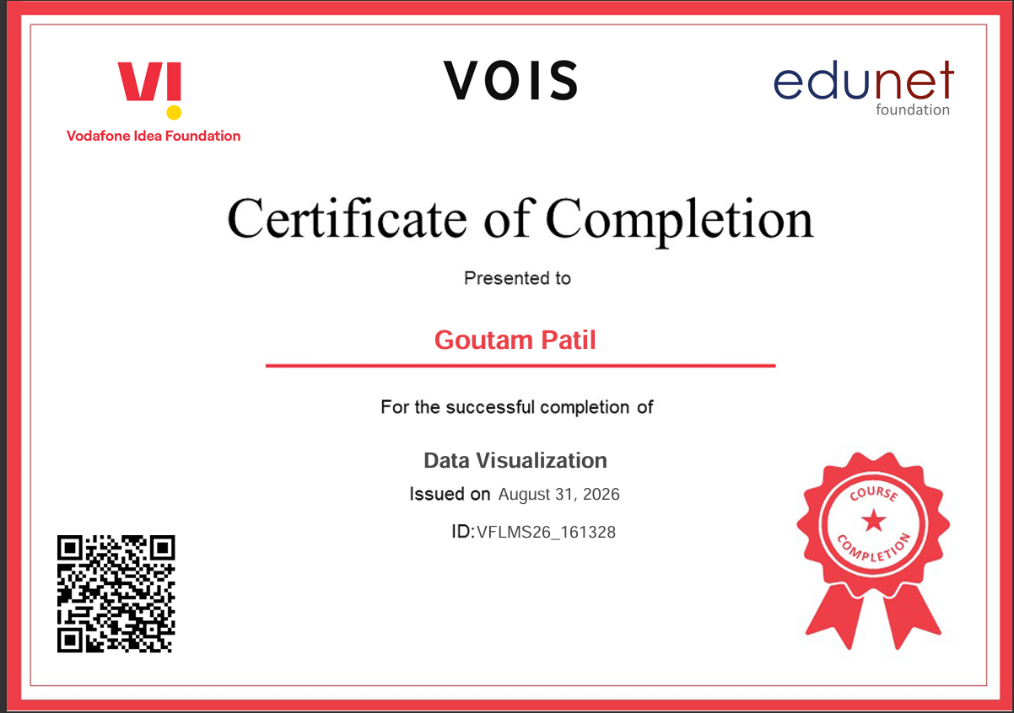
VOIS Course completion certificate -
Course name- Data Visualization
9/3/2026
Annual Review
‹#›

Slide 14
Thank you
.
.
9/3/2026
Annual Review
‹#›

